Slide 1
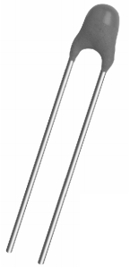
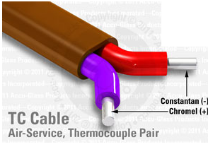
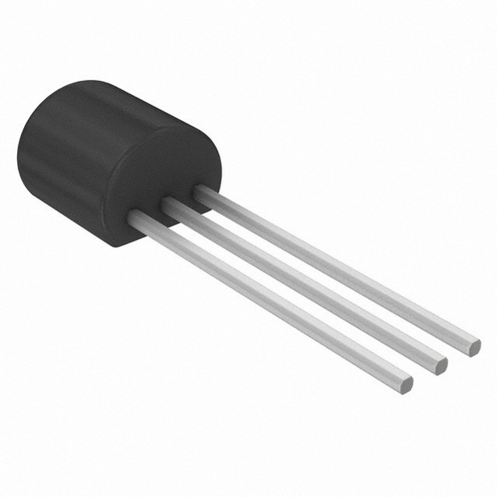
Engineering 80 – Spring 2016
Temperature Measurements
SOURCE: http://www.eng.hmc.edu/NewE80/PDFs/VIshayThermDataSheet.pdf
SOURCE: http://elcodis.com/photos/19/51/195143/to-92-3_standardbody__to-226_straightlead.jpg
SOURCE: http://www.accuglassproducts.com/product.php?productid=17523

Slide 2
What You’ll Be Learning About Today…
  Measuring Temperature
  Types of Temperature Sensors
    Thermistor
    Integrated Silicon Linear Sensor
    Thermocouple
    Resistive Temperature Detector (RTD)
  Choosing a Temperature Sensor
  Calibrating Temperature Sensors
  Thermal System Transient Response

Slide 3

What is Temperature?
SOURCE: http://www.clker.com/cliparts/6/5/b/f/11949864691020941855smiley114.svg.med.png

Slide 4
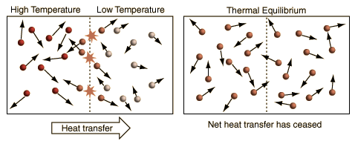
What is Temperature?
units
AN OVERLY SIMPLIFIED DESCRIPTION OF TEMPERATURE
SOURCE: http://hyperphysics.phy-astr.gsu.edu/hbase/thermo/temper2.html#c1
"Temperature is a measure of the tendency of an object to spontaneously give up energy to its surroundings. When two objects are in thermal contact, the one that tends to spontaneously lose energy is at the higher temperature.“
(Schroeder, Daniel V. An Introduction to Thermal Physics, 1st Edition (Ch, 1). Addison-Wesley.)

Slide 5
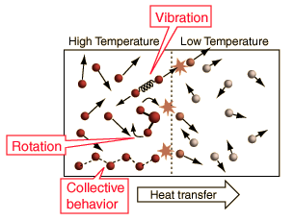
What is Temperature?
units
A SIMPLIFIED DESCRIPTION OF TEMPERATURE
SOURCE: http://hyperphysics.phy-astr.gsu.edu/hbase/thermo/temper2.html#c1
"Temperature is a measure of the tendency of an object to spontaneously give up energy to its surroundings. When two objects are in thermal contact, the one that tends to spontaneously lose energy is at the higher temperature.“
(Schroeder, Daniel V. An Introduction to Thermal Physics, 1st Edition (Ch, 1). Addison-Wesley.)

Slide 6
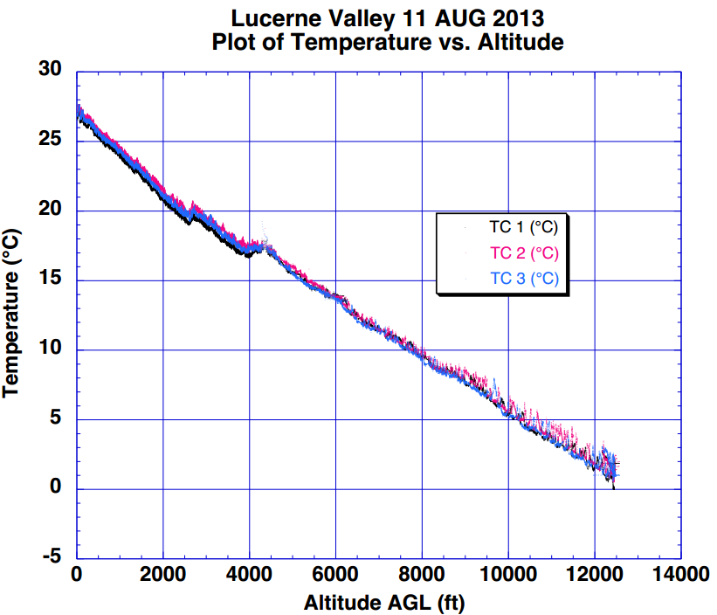

Measuring Temperature with Rockets
What are desirable characteristics of a temperature sensor?

Slide 7
Desirable Temperature Sensor Characteristics
FAST RESPONSE
ACCURATE
REPEATABLE
EASY CALIBRATION
WIDE TEMPERATURE RANGE
TEMPERATURE SENSOR
COST
SIMPLE RELATIONSHIP
SENSOR OUTPUT → TEMPERATURE

Slide 8
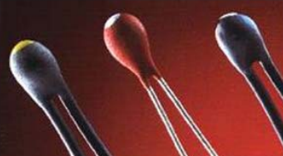
Thermistor
Thermistor – a resistor whose resistance changes with temperature
Resistive element is generally a metal-oxide ceramic containing Mn, Co, Cu, or Ni
Packaged in a thermally conductive glass bead or disk with two metal leads
Suppose we have a “1 kΩ thermistor”
  What does this mean?
  At room temperature, the resistance of the thermistor is 1 kΩ
  What happens to resistance as we increase temperature?

Slide 9
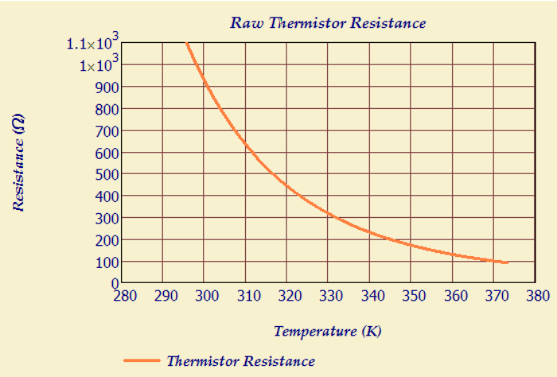
Negative Temperature Coefficient
Most materials exhibit a negative temperature coefficient (NTC)
  Resistance drops with temperature!

Slide 10

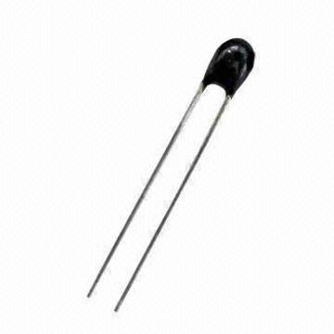
Converting Resistance to Temperature
The Steinhart-Hart Equation relates temperature to resistance
T is the temperature (in Kelvin)
R is the resistance at T and R_{ref} is resistance at T_{ref}
A₁, B₁, C₁, and D₁ are the Steinhart-Hart Coefficients
HOW COULD WE DETERMINE THESE COEFFICIENTS?
SOURCE: http://p.globalsources.com/IMAGES/PDT/B1055847338/Thermistor.jpg

Slide 11
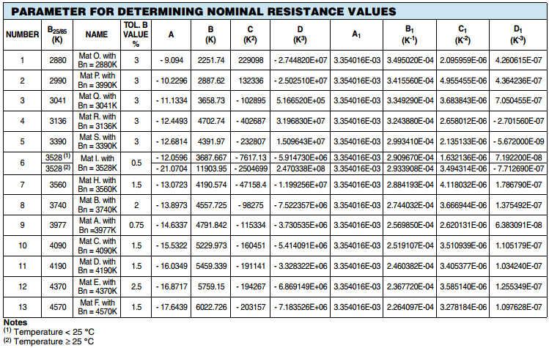
Converting Resistance to Temperature

Slide 12
Converting Resistance to Temperature
The Steinhart-Hart Equation relates temperature to resistance
T is the temperature (in Kelvin)
R is the resistance at T and R_{ref} is resistance at T_{ref}
A₁, B₁, C₁, and D₁ are the Steinhart-Hart Coefficients
HOW COULD WE DETERMINE THESE COEFFICIENTS?
  Take a look at the data sheet
  Measure 3 resistances at 3 temperatures
    Matrix Inversion (Linear Algebra)
SOURCE: http://p.globalsources.com/IMAGES/PDT/B1055847338/Thermistor.jpg

Slide 13
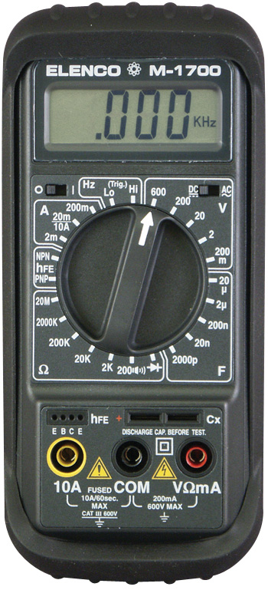
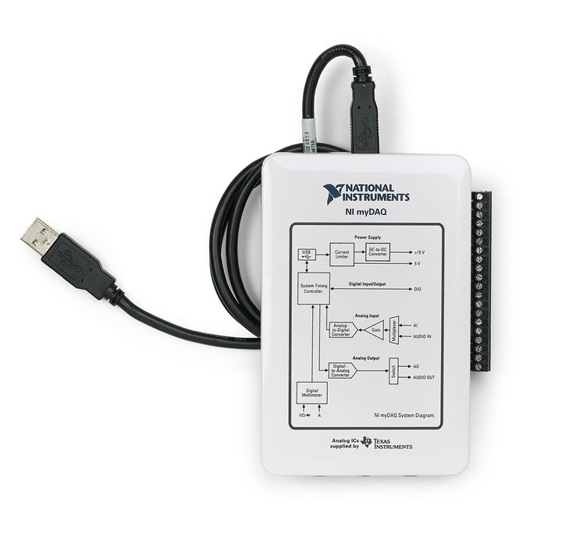
How is Resistance Measured?
SOURCE: http://images.studica.com/images/product/National-Instruments-students-ni-labview-mydaq/51NI%20myDAQ%20Device%2005041223.jpg
SOURCE: http://cdn.teachersupplysource.com/images/D/024-ENC-M-1700.jpg
SOURCE: http://p.globalsources.com/IMAGES/PDT/B1055847338/Thermistor.jpg

Slide 14

Thermistor Resistance (R_{T})
A thermistor produces a resistance (R_{T}), which could be converted to a voltage signal
HOW COULD WE DO THIS?
SOURCE: http://2.bp.blogspot.com/-Pwxc29B8fkU/VHDBayyJGmI/AAAAAAAAAOw/Po9R4z7WPYI/s1600/Baby-Making-Funny-Face.png

Slide 15
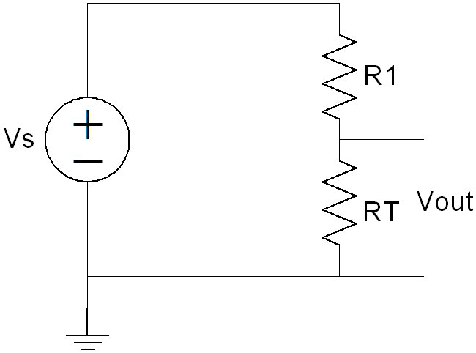



Thermistor Resistance (R_{T})
A thermistor produces a resistance (R_{T}), which could be converted to a voltage signal

Slide 16
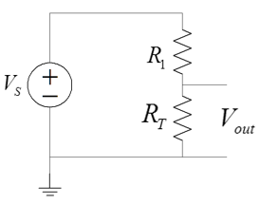
Power Dissipation in Thermistors
A current must pass through the thermistor to measure the voltage and calculate the resistance
The current flowing through the thermistor generates heat because the thermistor dissipates electrical power
P = I²R_{T}
The heat generated causes a temperature rise in the thermistor
This is called Self-Heating
WHY IS SELF-HEATING BAD?
I

Slide 17
Power Dissipation and Self-Heating
Self-Heating can introduce an error into the measurement
The increase in device temperature (ΔT) is related to the power dissipated (P) and the power dissipation factor (δ)
P = δ ΔT
Where P is in [W], ΔT is the rise in temperature in [ºC]
Suppose I = 5 mA, R_{T} = 4 kΩ, and δ = 0.067 W/ºC, what is ΔT?
(0.005 A)²(4000 Ω) = (0.067 W/ºC) ΔT
ΔT = 1.5 ºC
What effect does a ΔT of 1.5 ºC have on your thermistor measurements?
How can we reduce the effects of self-heating?
  Increase the resistance of the thermistor!

Slide 18
Thermistor Signal Conditioning Circuit
A voltage divider and a unity gain buffer will be used to measure temperature in the lab

Slide 19
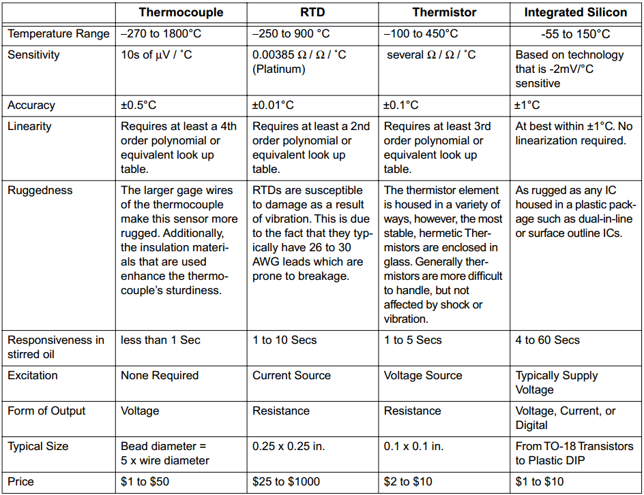
Summary Thus Far…
>

Slide 20
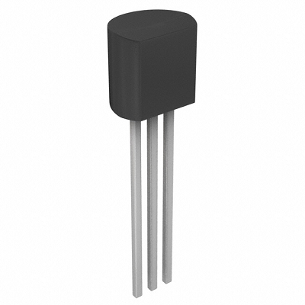
Integrated Silicon Linear Sensors
SOURCE: https://labjack.com/sites/default/files/LM34CAZ_1.png

Slide 21
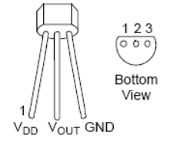

Integrated Silicon Linear Sensors
An integrated silicon linear sensor is a three-terminal device
  Power and ground inputs
  Relatively simple to use and cheap
  Circuitry inside does linearization and signal conditioning
  Produces an output voltage linearly dependent on temperature
3.1 – 5.5 V

Slide 22
Integrated Silicon Linear Sensors
An integrated silicon linear sensor is a three-terminal device
  Power and ground inputs
  Relatively simple to use and cheap
  Circuitry inside does linearization and signal conditioning
  Produces an output voltage linearly dependent on temperature
  When compared to other temperature measurement devices, these sensors are LESS accurate, operate over a NARROWER temperature range, and are LESS responsive
3.1 – 5.5 V

Slide 23
Summary Thus Far…
>

Slide 24

Thermocouple
Thermocouple – a two-terminal element consisting of two dissimilar metal wires joined at the end
SOURCE: http://upload.wikimedia.org/wikipedia/en/e/ed/Thermocouple_(work_diagram)_LMB.png

Slide 25
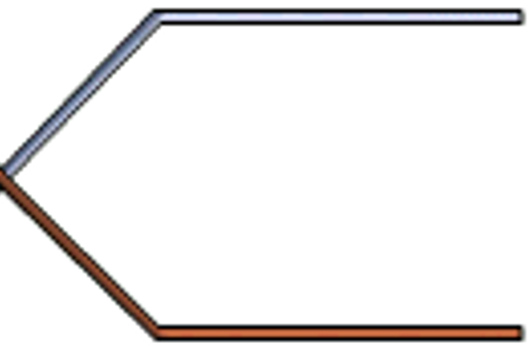
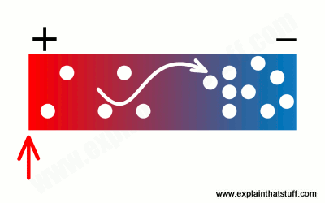

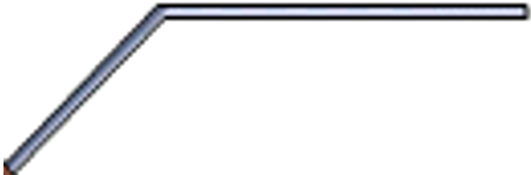
The Seebeck Effect
Seebeck Effect – A conductor generates a voltage when it is subjected to a temperature gradient
SOURCE: http://www.explainthatstuff.com/howthermocoupleswork.html

Slide 26
The Seebeck Effect
Seebeck Effect – A conductor generates a voltage when it is subjected to a temperature gradient
  Measuring this voltage requires the use of a second conductor material
Nickel-Chromium Alloy
Will I observe a difference in voltage at the ends of two wires composed of the same material?
Nickel-Chromium Alloy

Slide 27
The Seebeck Effect
Seebeck Effect – A conductor generates a voltage when it is subjected to a temperature gradient
  Measuring this voltage requires the use of a second conductor material
  The other material needs to be composed of a different material
Nickel-Chromium Alloy
+
The relationship between temperature difference and voltage varies with materials
The voltage difference of the two dissimilar metals can be measured and related to the corresponding temperature gradient
V_{S} = SΔT
-
Copper-Nickel Alloy

Slide 28
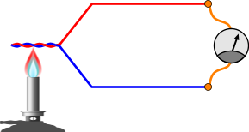
Measuring Temperature
To measure temperature using a thermocouple, you can’t just connect the thermocouple to a measurement system (e.g. voltmeter)
The voltage measured by your system is proportional to the temperature difference between the primary junction (hot junction) and the junction where the voltage is being measured (Ref junction)
SOURCE: http://www.pcbheaven.com/wikipages/images/thermocouples_1271330366.png

Slide 29
Measuring Temperature
To measure temperature using a thermocouple, you can’t just connect the thermocouple to a measurement system (e.g. voltmeter)
The voltage measured by your system is proportional to the temperature difference between the primary junction (hot junction) and the junction where the voltage is being measured (Ref junction)
To determine the absolute temperature at the hot junction…
You need to know the temperature at the Ref junction!
How can we determine the temperature at the reference junction?
SOURCE: http://www.pcbheaven.com/wikipages/images/thermocouples_1271330366.png

Slide 30
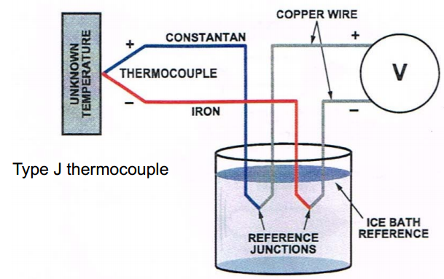
Ice Bath Method (Forcing a Temperature)
Thermocouples measure the voltage difference between two points
To know the absolute temperature at the hot junction, one must know the temperature at the Ref junction
NIST thermocouple reference tables are generated with T_{ref} = 0 ºC
V_{meas} = V(T_{hot}) – V(T_{ref})
V(T_{hot}) = V_{meas} + V(T_{ref})
If we know the voltage-temperature relationship of our thermocouple, we could determine the temperature at the hot junction
IS IT REALLY THAT EASY?

Slide 31
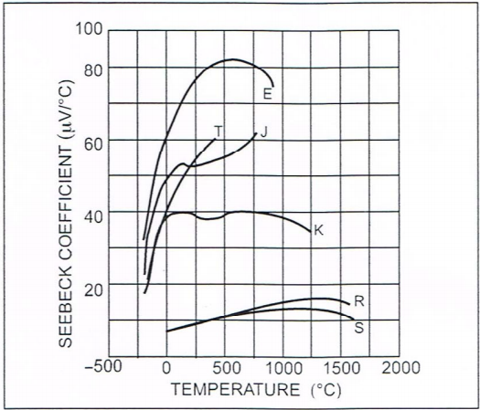
Nonlinearity in the Seebeck Coefficient
V_{S} = SΔT
Thermocouple output voltages are highly nonlinear
The Seebeck coefficient can vary by a factor of 3 or more over the operating temperature range of the thermocouples

Slide 32
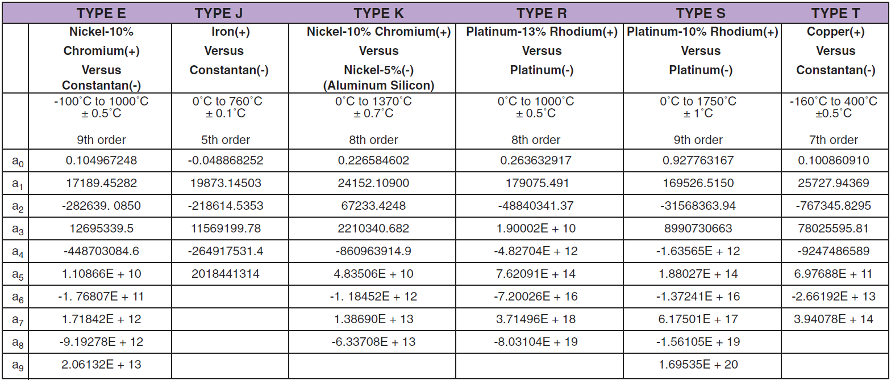
Temperature Conversion Equation
T = a₀ + a₁V + a₂V² + …. + a_{n}V^{n}

Slide 33
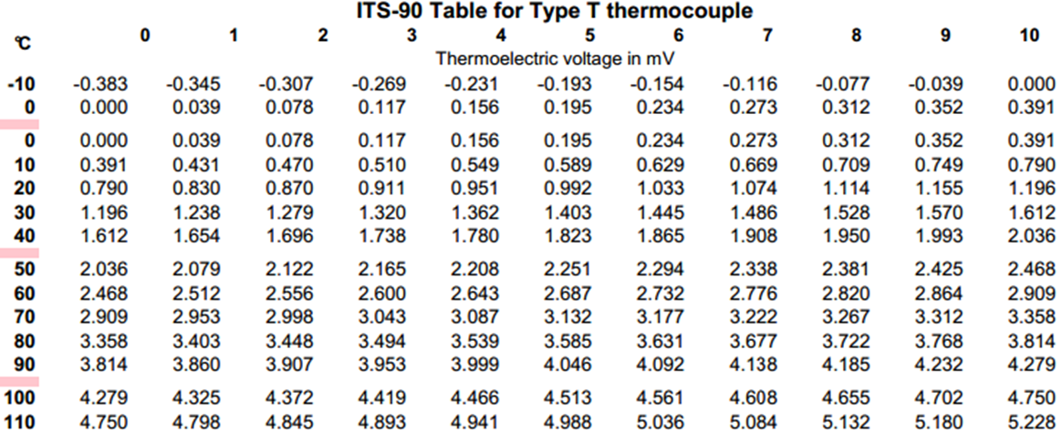
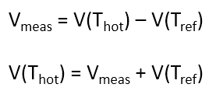
Look-Up Table for a Type T Thermocouple
Voltage difference of the hot and cold junctions: V_{meas} = 3.409 mV
What is the temperature of the hot junction if the cold junction is at 22 ºC?
At 22 ºC, the reference junction voltage is 0.870 mV
The hot junction voltage is therefore 3.409 mV + 0.870 mV = 4.279 mV
The temperature at the hot junction is therefore 100 ºC

Slide 34
APPLYING WHAT WE’VE LEARNED
Voltage difference of the hot and cold junctions: V_{meas} = 4.472 mV
What is the temperature of the hot junction if the cold junction is at –5 ºC?
At -5 ºC, the cold junction voltage is –0.193 mV
The hot junction voltage is therefore 4.472 mV – 0.193 mV = 4.279 mV
The temperature at the hot junction is therefore 100 ºC

Slide 35
Is This Really Practical For a Rocket?
What is another method of determining the temperature at the reference junction?

Slide 36
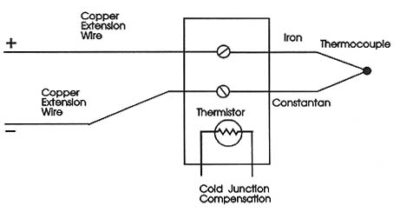
Cold Junction Compensation
SOURCE: http://www.industrial-electronics.com/DAQ/images/10_13.jpg

Slide 37
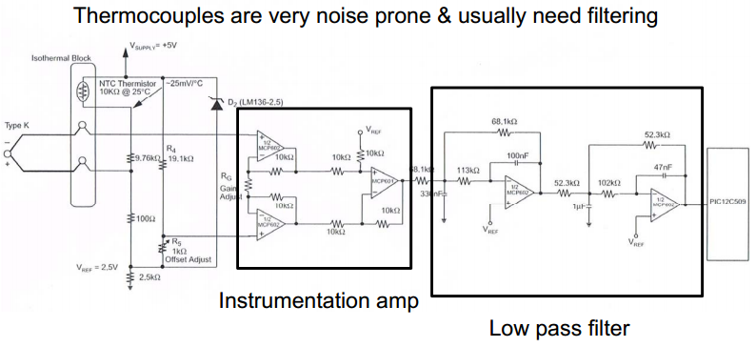
Acquiring Data

Slide 38
Temperature Measurement Devices in Lab
>

Slide 39
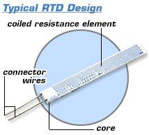
Resistive Temperature Detector (RTD)
Two terminal device
Usually made out of platinum
Positive temperature coefficient
Tends to be linear
R = R₀(1+α)(T-T₀) where T₀ = 0ºC
R₀ = 100 Ω, α = 0.03385 Ω/ Ω ºC
At 10ºC, R = 100(1+0.385)(10) = 103.85 Ω
They are best operated using a small constant current source
Accuracy of 0.01 ºC
EXPENSIVE!
SOURCE: http://www.omega.com/prodinfo/images/RTD_diag1.gif

Slide 40
Temperature Measurement Devices
>

Slide 41
How Do I Know If These Are Working?
SOURCE: http://www.eng.hmc.edu/NewE80/PDFs/VIshayThermDataSheet.pdf
SOURCE: http://elcodis.com/photos/19/51/195143/to-92-3_standardbody__to-226_straightlead.jpg
SOURCE: http://www.accuglassproducts.com/product.php?productid=17523

Slide 42
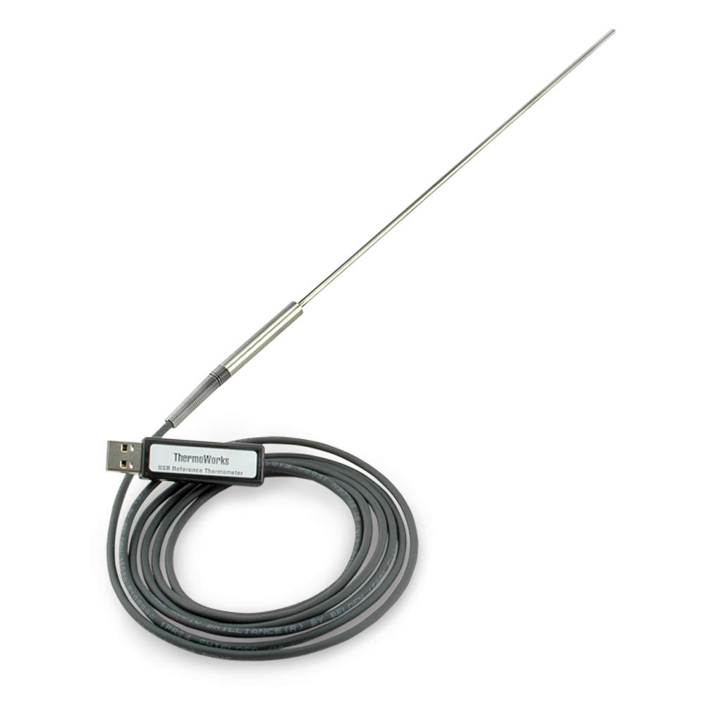

Calibration
Each probe includes an individual NIST-Traceable calibration certificate with test data at 0, 25, 70, and 100°C.
How could we calibrate a temperature sensor?
SOURCE: http://www.thermoworks.com/products/calibration/usb_reference.html
0 ºC
25 ºC
100 ºC

Slide 43

Tracking the Rate of Temperature Change
If a slow sensor is placed into a rocket that is launched to a high altitude, the sensor may not be able to track the rate of temperature change
A critical property of a temperature-measurement device is how quickly it responds to a change in external temperature

Slide 44

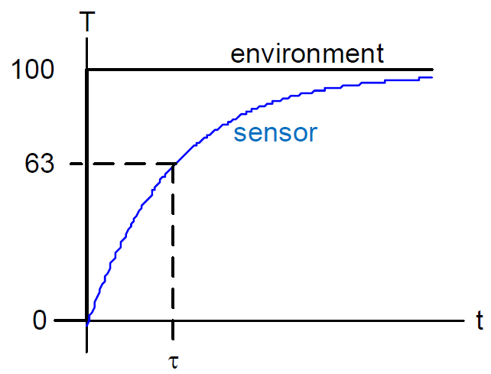


Thermal System Step Response
The thermal time constant can be measured as the time it takes to get to (1/e) of the final temperature
100 (1-(1/e)) = 63 ºC
Thermal Time Constant

Slide 45
SUMMARY
  Measuring Temperature
  Types of Temperature Sensors
    Thermistor
    Integrated Silicon Linear Sensor
    Thermocouple
    Resistive Temperature Detector (RTD)
  Choosing a Temperature Sensor
  Calibrating Temperature Sensors
  Thermal System Transient Response

